Slide 1
Oregon Resource Allocation Advisory Committee
Advisory Committee Meeting
August 25, 2022

Slide 2
Interpretation
Click the globe to enable interpretation options.
Select the language.
You can choose to hear the original audio at a lower volume or select “mute original audio” to stop hearing the original audio.

Slide 3
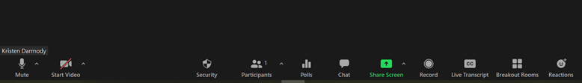
Zoom Features
Your microphone and video controls
List of who is present
Chat feature (will open in a new window)

Slide 4
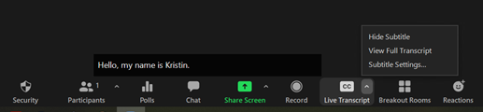
Captions and Transcript
Click the small arrow next to “CC Live Transcript” to access caption controls.
You can hide the subtitles or view the full transcript.

Slide 5
Meeting Resources
If you need support, we have:
Simultaneous Spanish language interpretation
Technology support
Note taker
If you have a need, contact Lisa Bui at: 503-576-9321
Please note that this meeting will be open to the PUBLIC
1. The general public may be in attendance
2. The meeting summary will be posted to OHA’s website
Notes:
Lisa can be main point of contact to triage needs and connect folks to the right person during the meeting
Let committee know that anything entered into the chat is subject to disclosure under public records law

Slide 6
Agenda
Welcome
Defining Structural Discrimination
Break
Disadvantage Indices and Crisis Standards of Care
Topics for Future Discussion
Total 120 minutes (2 hours)

Slide 7
Purpose
This meeting will be a presentation on health justice considerations for Crisis Standards of Care / Crisis Care Guidelines. These topics are being introduced to level-set the committee’s understanding of structural discrimination before exploring how crisis care operates and the ways it needs to shift.

Slide 8
Check-in
What is one skill you could teach others?

Slide 9
Defining Structural Discrimination

Slide 10
What is Structural Discrimination?
The ways that laws, policies and practices are used to advantage dominant groups and disadvantage minority groups
The use of neutral laws, policies and practices that fail to account for the inequities experienced by minority groups and individuals
It does not require bad intent or individuals (Yearby, 2020)
Copyright © 2022 by Ruqaiijah Yearby. All rights reserved.

Slide 11
Examples of Structural Discrimination
Allowing employers to require individuals with disabilities to come to work, but allowing hybrid or virtual options during a pandemic when it benefited individuals without disabilities
Allowing employers to use salary history to pay racial and ethnic minority individuals less than white individuals although they are doing the same job as white individuals
Copyright © 2022 by Ruqaiijah Yearby. All rights reserved.

Slide 12
Structural Discrimination Questions
Have you experienced structural discrimination?
How has structural discrimination affected your community?
Copyright © 2022 by Ruqaiijah Yearby. All rights reserved.

Slide 13
Structural Discrimination and Health Inequities, pt. 1
Minority groups are:
  Disproportionately poor
  Live in unsafe housing and
  Lack access to healthcare services
As a result, minority groups tend to have poor health status and outcomes compared to the dominant group
Copyright © 2022 by Ruqaiijah Yearby. All rights reserved.

Slide 14
Structural Discrimination and Health Inequities, pt. 2
In large part because of structural discrimination, minority groups tend to have:
  higher rates of chronic diseases and poor health status
  lower life expectancy
Copyright © 2022 by Ruqaiijah Yearby. All rights reserved.

Slide 15
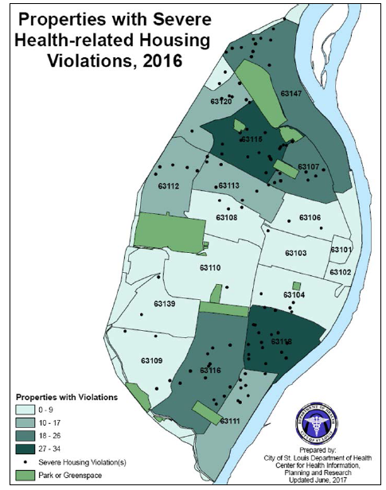
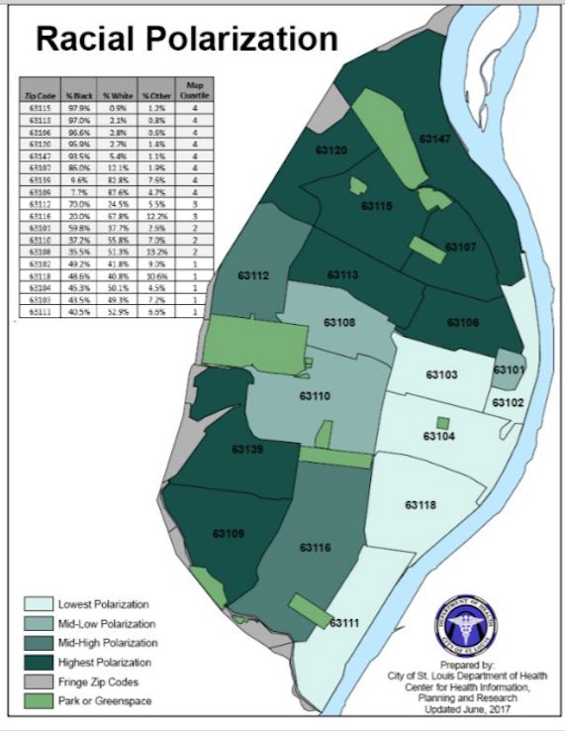
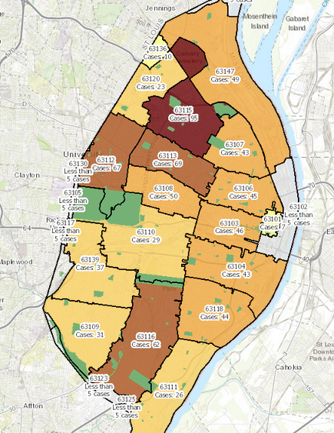
Structural Discrimination and Health Inequities, pt. 3
Copyright © 2022 by Ruqaiijah Yearby. All rights reserved.

Slide 16
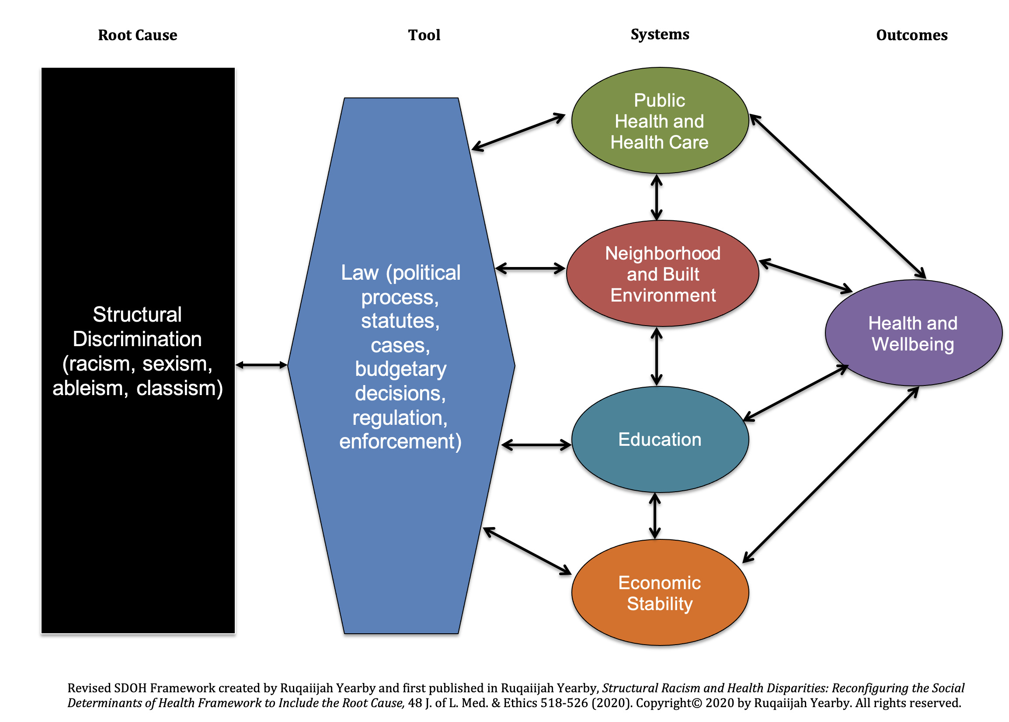
Revised Social Determinants of Health Model ©
Copyright © 2022 by Ruqaiijah Yearby. All rights reserved.

Slide 17
Structural Discrimination and Crisis Standards of Care (CSC), pt. 1
CSC use neutral measures like the 5-year survival rate, life expectancy and the sequential organ failure assessment (SOFA) to determine which patients to prioritize for care
CSC disadvantage minority groups because they tend to have worse 5-year survival rates, life expectancy, and SOFA scores than the dominant group
Copyright © 2022 by Ruqaiijah Yearby. All rights reserved.

Slide 18
Structural Discrimination and CSC, pt. 2
Minority groups often are not involved in the development or implementation of CSC
Thus, their needs and experiences are often ignored or discounted
Copyright © 2022 by Ruqaiijah Yearby. All rights reserved.

Slide 19
Take a 5-minute break

Slide 20
Disadvantage Indices

Slide 21
Disadvantage Indices
Indices created by the government to measure disadvantage at different geographical levels
Used to distribute resources during natural or man-made disasters or disease outbreaks
Some indices include social categories like disability status and race to determine disadvantage, while others focus on access to resources to determine disadvantage
Copyright © 2022 by Ruqaiijah Yearby. All rights reserved.

Slide 22
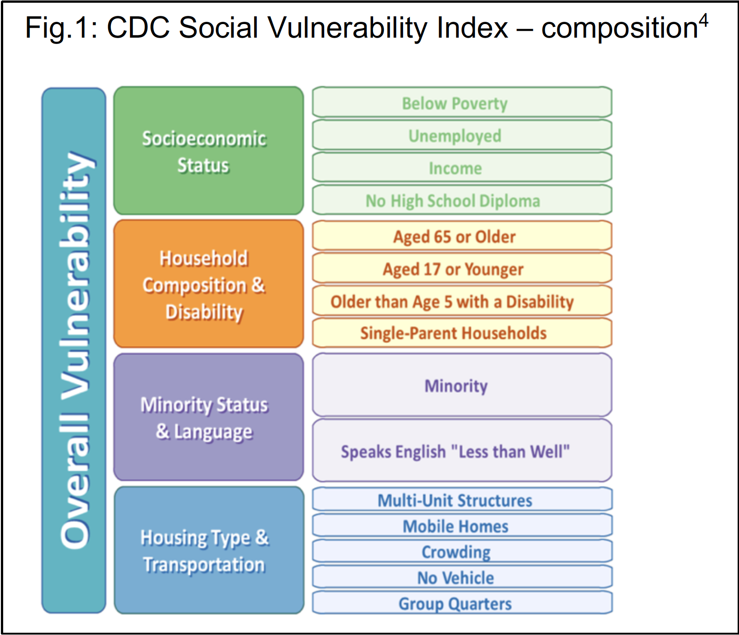
Social Vulnerability Index

Slide 23
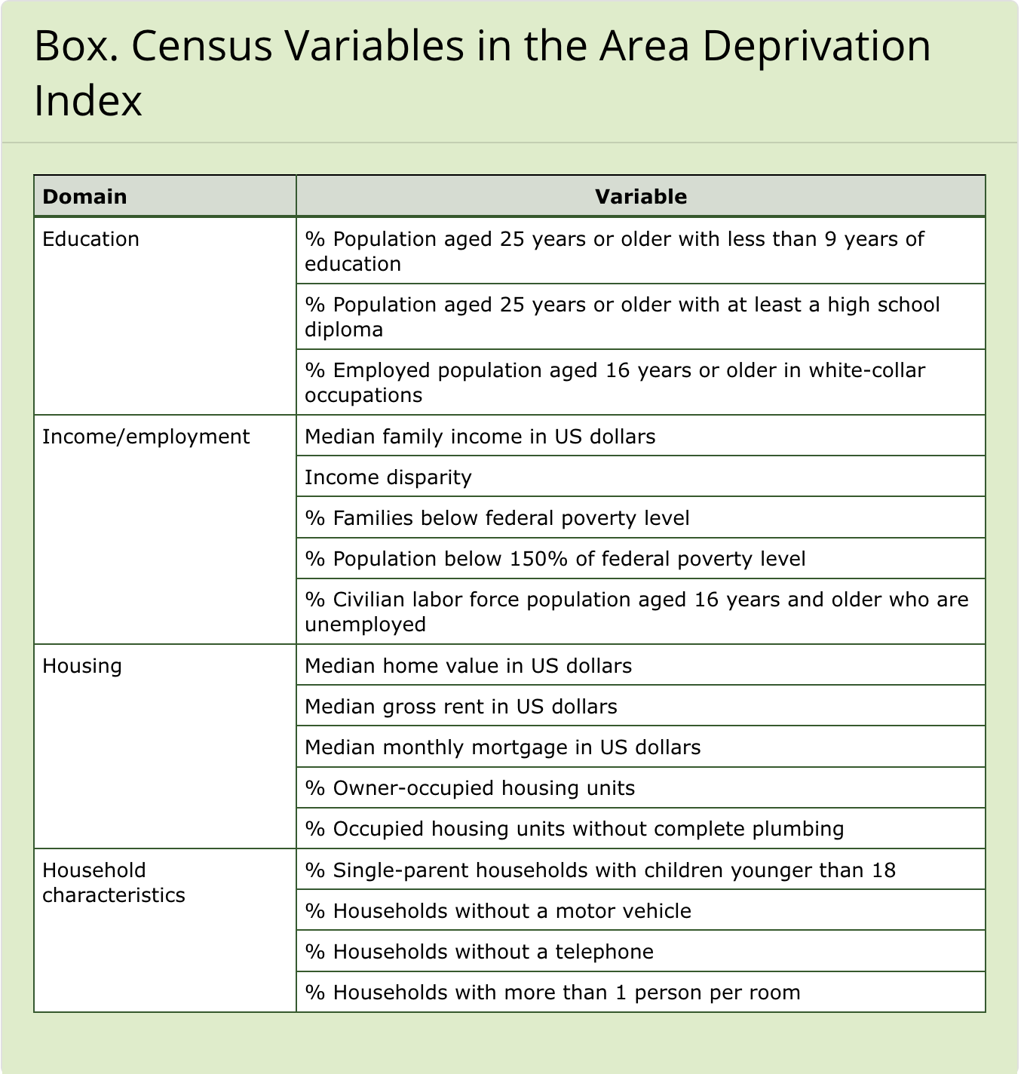
Area Depravation Index

Slide 24
Indices Pair Share Questions
What do you like about the indices?
Do the indices capture your personal experience?
Do the indices include all the barriers your community experiences?
Copyright © 2022 by Ruqaiijah Yearby. All rights reserved.

Slide 25
Disadvantage Indices and decision-making
Disadvantage Indices were used during the Covid-19 vaccine allocation and distribution process
During this process, some governmental officials consulted with community members and often shared decision-making authority with communities to allocate and distribute vaccines
Alaska is a great example
Copyright © 2022 by Ruqaiijah Yearby. All rights reserved.

Slide 26
Disadvantage Indices and CSC, pt. 1
Can be used to ensure that minority groups have equal access to healthcare services and treatments during a crisis
Instead of using neutral measures that disadvantage minority groups, indices can be used to identify who is the neediest and prioritize them for care
Copyright © 2022 by Ruqaiijah Yearby. All rights reserved.

Slide 27
Disadvantage Indices and CSC, pt. 2
Can also be used to ensure that minority groups participate in the decision-making process concerning the allocation and distribution of health care services and treatments during a crisis
Copyright © 2022 by Ruqaiijah Yearby. All rights reserved.

Slide 28
Benefits of using Disadvantage Indices
Data is readily available
Addresses inequities caused by structural discrimination
Makes the allocation of scarce resources fair
Provides opportunity for shared decision-making
Copyright © 2022 by Ruqaiijah Yearby. All rights reserved.

Slide 29
Limitations of using Disadvantage Indices
Not originally created to be used to allocate healthcare services and treatment
Gaps in the data
Complexity of using indices
Copyright © 2022 by Ruqaiijah Yearby. All rights reserved.

Slide 30
Indices Large Group Discussion Questions
What is missing from the indices?
What are some barriers to using the indices?
What are your concerns with using indices?
Copyright © 2022 by Ruqaiijah Yearby. All rights reserved.

Slide 31
Health Equity and Health Justice
Health Equity is achieved when every person has the opportunity to “attain his or her full health potential” and no one is “disadvantaged from achieving this potential because of social position or other socially determined circumstances
Health Justice is achieved when structural discrimination is eliminated, and minority groups have the power to develop solutions to achieve health equity for their communities (Benfer, Mohapatra, Wiley & Yearby, 2020)
Copyright © 2022 by Ruqaiijah Yearby. All rights reserved.

Slide 32
Topics for Future Discussions

Slide 33
Topics for Future Discussions
Health Justice versus Health Equity
Triage Tool and Individual Assessments
Legal Considerations: antidiscrimination and protected class
Triage Team
Equal Priority Resolution Process (tie breaker)
Communication and transparency

Slide 34
Input on Topics
Are we missing any important topics?
What are the priority topics to address from this list?
What do you believe is the best process for addressing this wide range of topics?

